Slide 1






Srishyla Educational Trust (R), Bheemasamudra
GM INSTITUTE OF TECHNOLOGY, DAVANGERE
(Affiliated to VTU Belagavi, Approved by AICTE, New Delhi & Govt. of Karnataka)
Department of Information Science and Engineering
Three Day Faculty Enablement Programme on
“Machine Learning and Implementations”
Organized in collaboration with IQAC-GMIT.
Key Note Address
Dr. Vinay V. Hegde
Associate Professor,
vinayvhegde@rvce.edu.in
Dept of CSE, R.V.College of Engineering, Bangalore

Slide 2
Talk Outline
Definition of Machine Learning ( ML)
Why ML?
Popular ML Applications
Mind Map of ML Algorithms
ML Principles and Classifications of ML Algorithm
ML Vocabulary and Terms ( Terminology)
Issues in ML, ML Vs AI, Data Science. ( Comparison)
ML Tools : JUPYTER , PANDA etc., ( practices)
Learning ML Process : Practical Approach ( Step by step)
Supervised and Unsupervised ML ( Types )
ML Model Generalization: Splitting in to Test and Training Data: Cross Validation procedures,
ML performance Metrics or Error Measurements
ML and Statistics

Slide 3
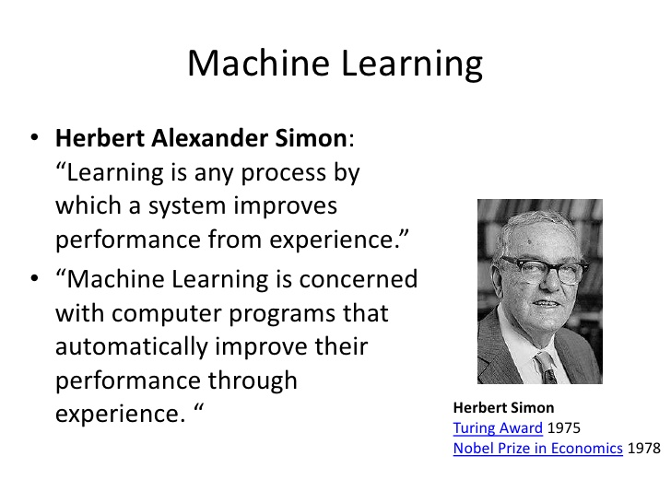

Introduction to Machine Learning
Machine Learning term coined by Frank Rosenblatt in 1957: Perceptron

Slide 4
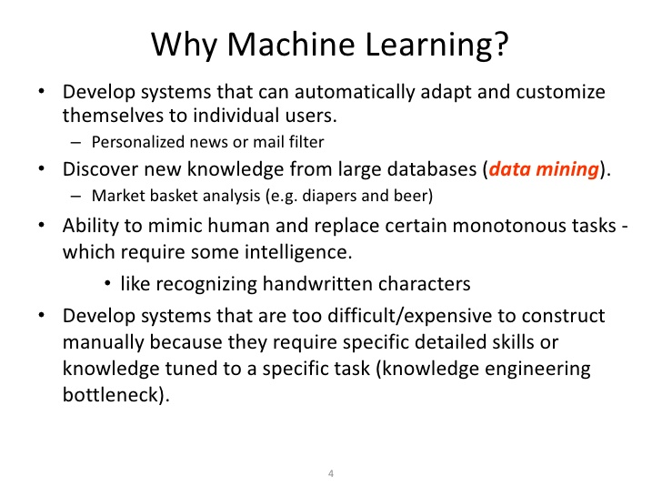

Think of a spreadsheet. You have columns, rows, and cells.
data plays a big part in machine learning.
The computer science perspective:
uses a row of data to describe an entity (like a person) or an observation about an entity.
As such, the columns for a row are often referred to as attributes of the observation and the rows themselves are called instances.

Slide 5
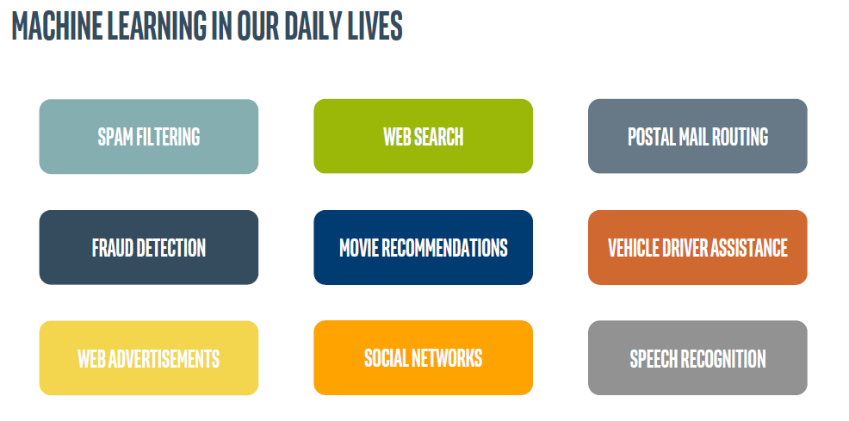
ML Applications

Slide 6
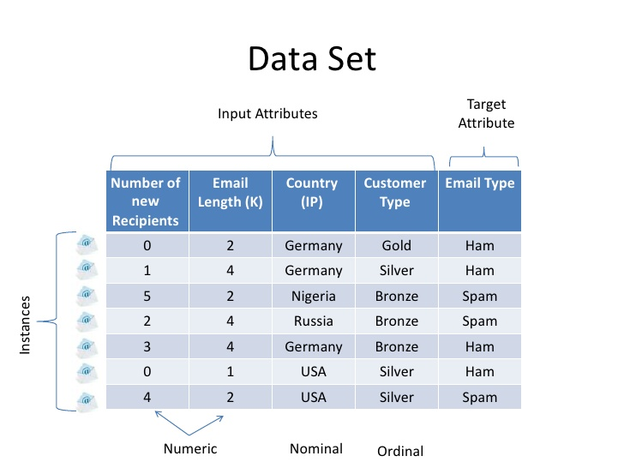
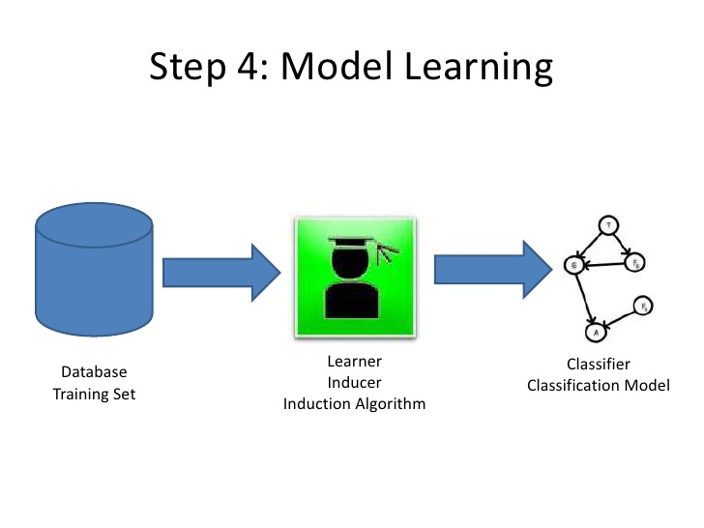
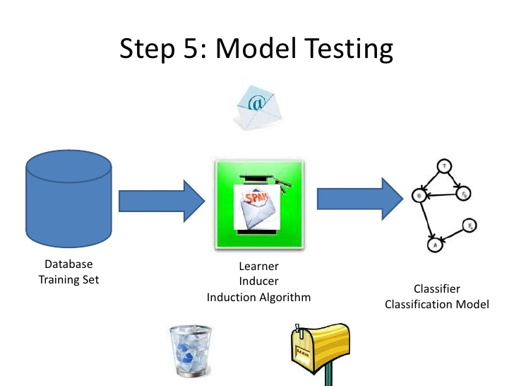
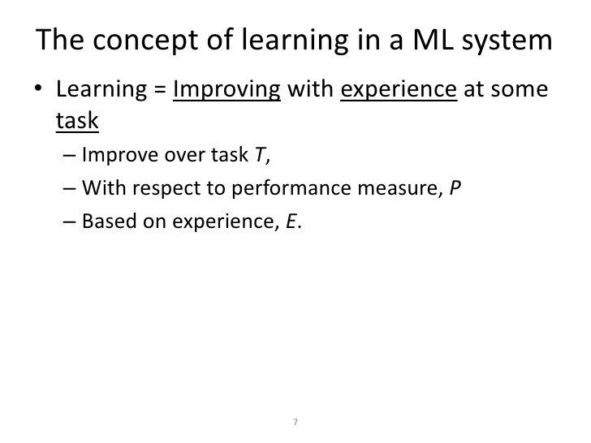
Example :
Task T : driving on public four lane highway using Vision sensors.
Performance measure P: average distance travelled before an error:
Training Experience E : sequence of images and steering commands while observing human driver.

Slide 7
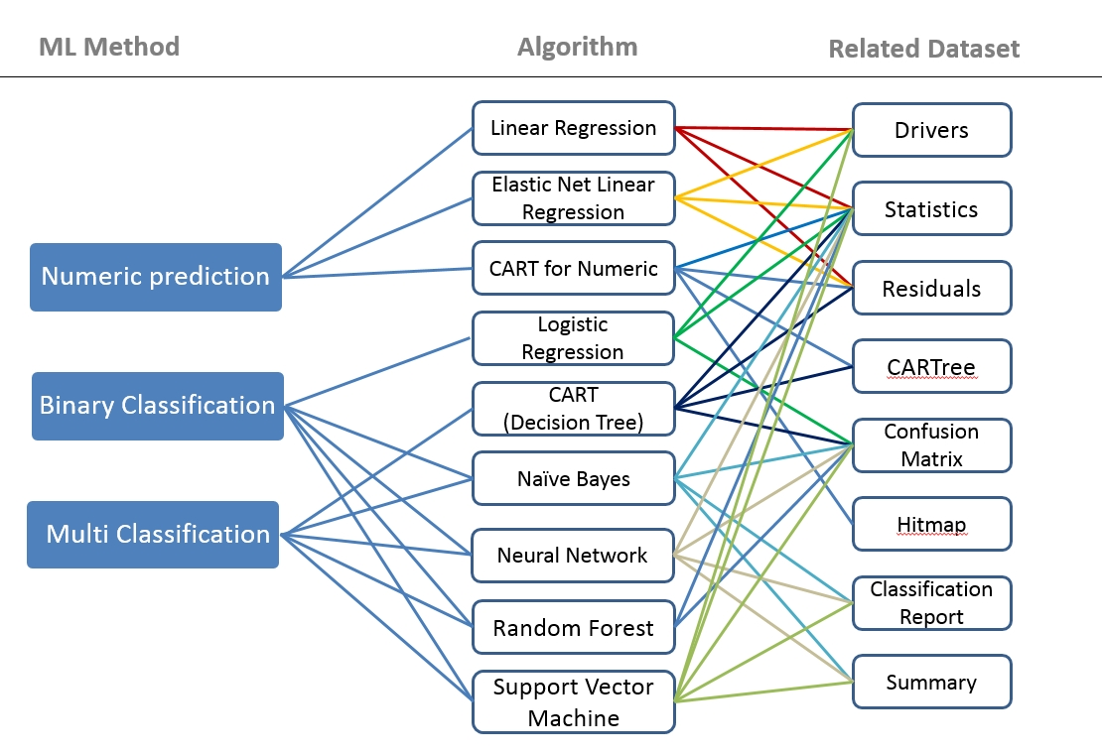

Slide 8
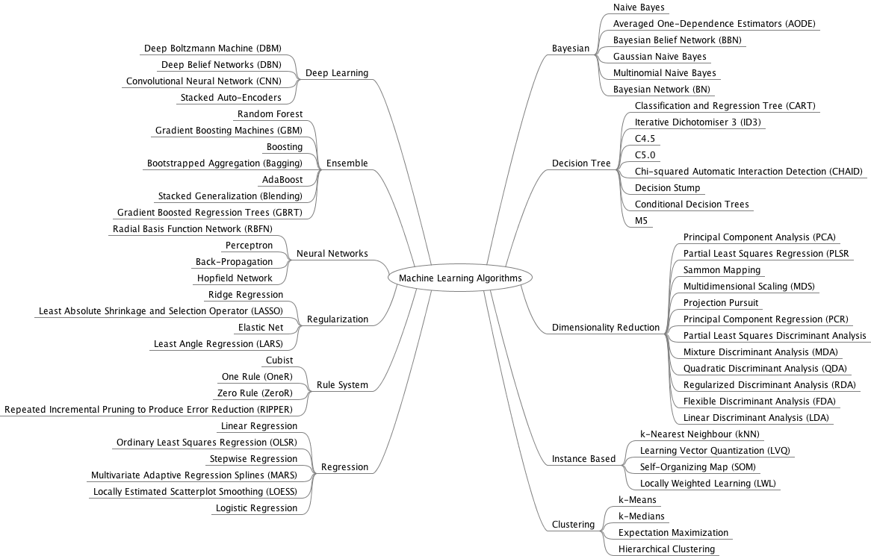
Mind Mapping Diagram of ML Algorithms

Slide 9
Machine Learning : Algorithm Foundations
How To Talk About Data in Machine learning?
Principle That Underpins All Algorithms:
Parametric and Nonparametric Algorithms:
Bias, Variance and the Trade-off:
data : a big part : ML. Think of a spreadsheet. You have columns, rows, and cells
Nonlinear Algorithms
Classification and Regression Trees
Naive Bayes
k-Nearest Neighbors
Learning Vector Quantization
Support Vector Machines
Ensemble Algorithms
Bagging and Random Forest
Boosting and AdaBoost
Linear Algorithms
Linear Regression Logistic Regression Linear Discriminant Analysis
ML –PRINCIPLE : (supervised machine learning algorithms : predictive modeling).
Machine learning algorithms are described as learning a target function (f) that best maps input variables (X) to an output variable (Y). Y = f(X)
This is a general learning task where we would like to make predictions in the future (Y) given new examples of input variables (X).
The most common type of machine learning is to learn the mapping Y = f(X) to make predictions of Y for new X. This is called predictive modeling or predictive analytics and our goal is to make the most accurate predictions possible.

Slide 10
Machine learning algorithms can best be understood through the lens of the bias-variance trade-off. Bias : simplifying assumptions : model to make the target function easier to learn.
Generally, parametric algorithms have a high bias : making them fast to learn : easier to understand but generally less flexible.
In turn, they have lower predictive performance on complex problems that fail to meet the simplifying assumptions of the algorithms bias.
Decision trees are an example of a low bias algorithm, whereas linear regression is an example of a high-bias algorithm.
Variance is the amount that the estimate of the target function will change if different training data was used. The target function is estimated from the training data by a machine learning algorithm, so we should expect the algorithm to have some variance, not zero variance.
The k-Nearest Neighbors algorithm is an example of a high-variance algorithm, whereas Linear Discriminant Analysis is an example of a low variance algorithm.
The goal of any predictive modeling machine learning algorithm is to achieve low bias and low variance. In turn, the algorithm should achieve good prediction performance. The parameterization of machine learning algorithms is often a battle to balance out bias and variance.
Increasing the bias will decrease the variance. Increasing the variance will decrease the bias.

Slide 11
what is a parametric machine learning algorithm ? How is it different from a nonparametric machine learning algorithm?
Assumptions can greatly simplify the learning process, but can also limit what can be learned. Algorithms that simplify the function to a known form are called parametric machine learning algorithms.
The algorithms involve two steps:
Select a form for the function.
Learn the coefficients for the function from the training data.
Some examples of parametric machine learning algorithms are Linear Regression and Logistic Regression.
Algorithms that do not make strong assumptions about the form of the mapping function are called nonparametric machine learning algorithms. By not making assumptions, they are free to learn any functional form from the training data.
Non-parametric methods are often more flexible, achieve better accuracy but require a lot more data and training time.
Examples of nonparametric algorithms include Support Vector Machines, Neural Networks and Decision Trees.

Slide 12
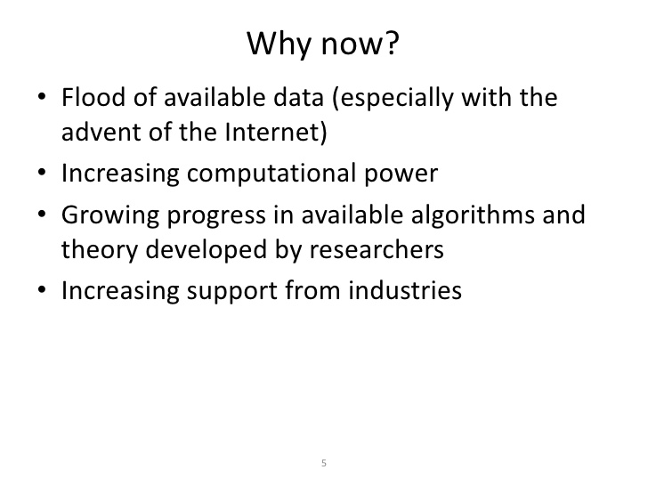
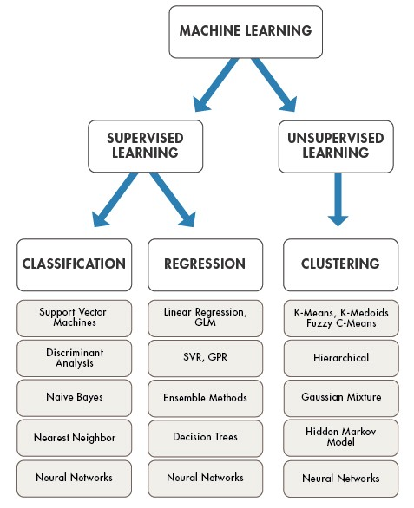
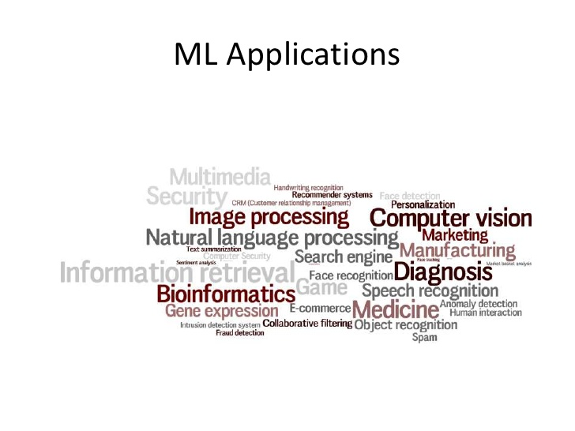
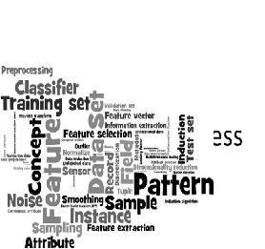

Slide 13
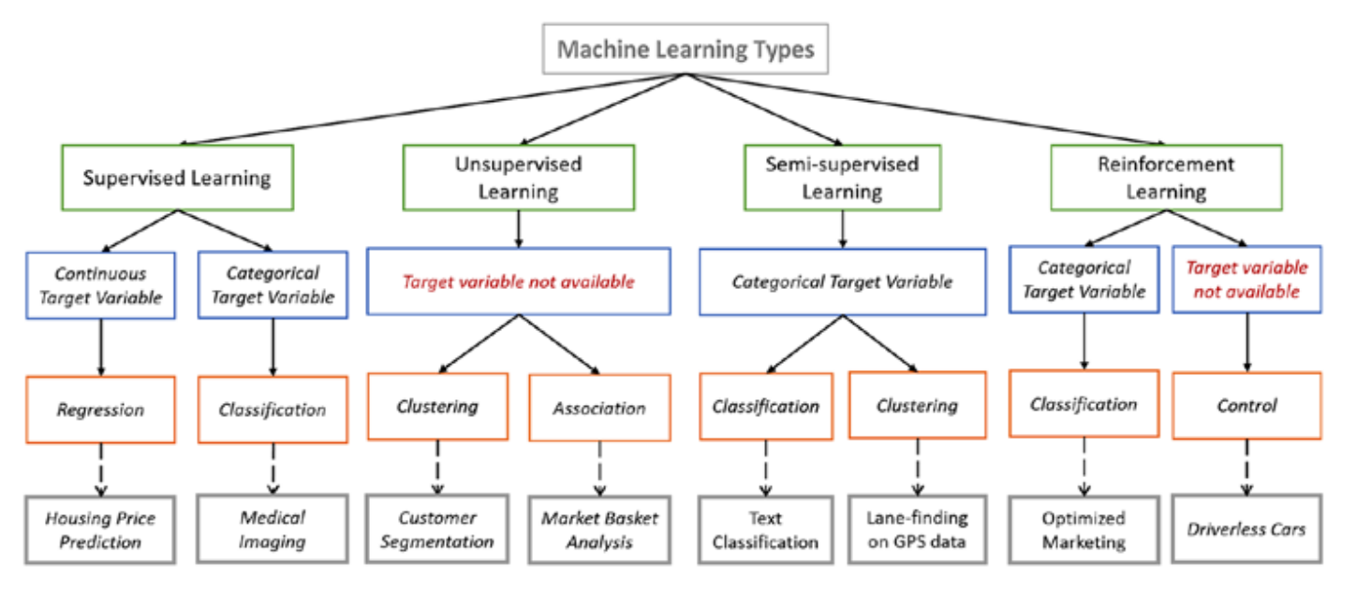
Issues in Machine Learning?
What Algorithms exist for learning general target functions from specific training.
How much Training data is sufficient?
When and how the prior Knowledge held by the learner guide the process of generalizing examples?
How to reduce learning task? How to alter representation to improve ?

Slide 14
Differences between ML Vs AI, Deep Learning, Data Science
Machine learning is a set of algorithms that train on a data set to make predictions
For instance, supervised classification algorithms used to classify potential clients into good or bad prospects, for loan purposes, based on historical data.
The techniques involved, for a given task (e.g. supervised clustering), are varied: naive Bayes, SVM, neural nets, ensembles, association rules, decision trees, logistic regression, or a combination of many
Data Science : ML and Statistics.
The word learning : Data : Training set: Model or algorithm parameters. Techniques such as (regression, naive Bayes - supervised clustering.)
unsupervised clustering - aims at detecting clusters and cluster structures without any a-priori knowledge or training set to help the classification algorithm.
A human being is needed to label the clusters found. Some techniques are hybrid, such as semi-supervised classification. Some pattern detection or density estimation techniques fit in this category.
All of this is a subset of data science. When
Algorithms are automated, as (automated piloting or driver-less cars) called AI, and specifically, deep learning.
If the data collected comes from sensors and if it is transmitted via the Internet, then it is ML or data science or
deep learning applied to IoT.

Slide 15
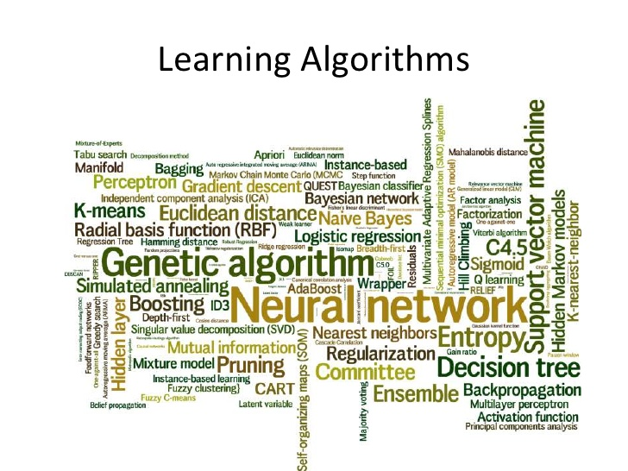
common principle :
all supervised machine learning algorithms are used for predictive modeling.
Machine learning algorithms are described as learning a
target function (f) that best maps input variables (X) to an output variable (Y).
Y = f(X)
This is a general learning task where we would like to make predictions in the future (Y) given new examples of input variables (X).
The most common type of machine learning is to learn the mapping Y = f(X) to make predictions of Y for new X. This is called predictive modeling or predictive analytics and our goal is to make the most accurate predictions possible

Slide 16
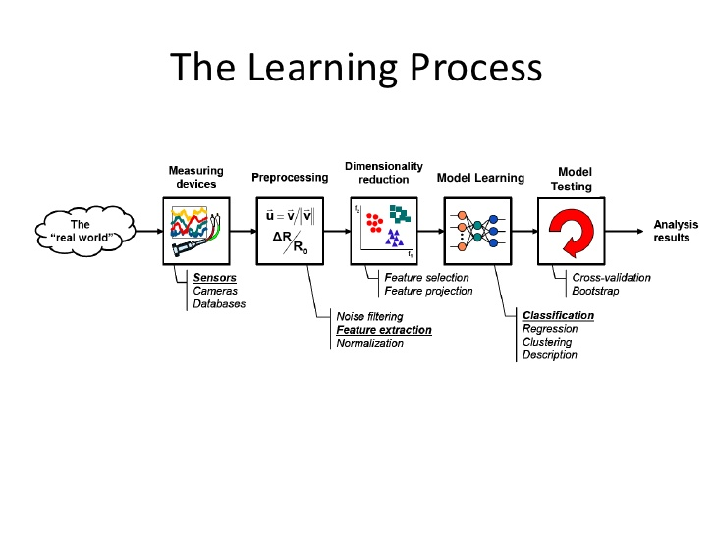
Learning to recognize- spoken words
Learning to drive an Autonomous Vehicle
Learning to classify new astronomical structures
Learning to play word class games.
Machine learning (Statistical Perspective) frames data in the context of a hypothetical function (f) that the machine learning algorithm aims to learn.
Given some input variables (Input) the function answer the question as to what is the predicted output variable (Output). Output = f(Input)

Slide 17
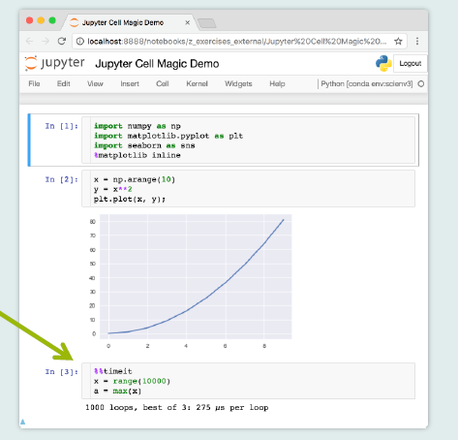
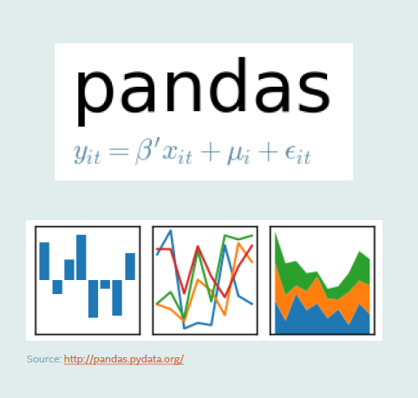
Machine Learning : Concept Learning : Tool Kit
Jupyter notebooks :
Interactive coding and Visualization of Output
NumPy,SciPy, Pandas
Numeric Computation
Matplotlib, Seaborn:
Data Visualization
Scikit- learn:
Machine Learning

Slide 18
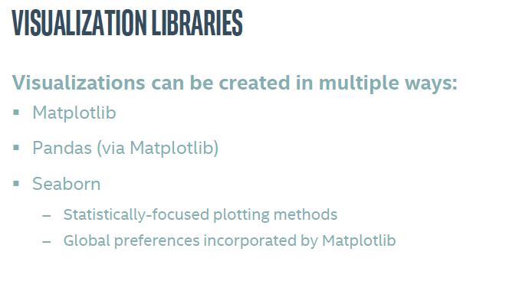
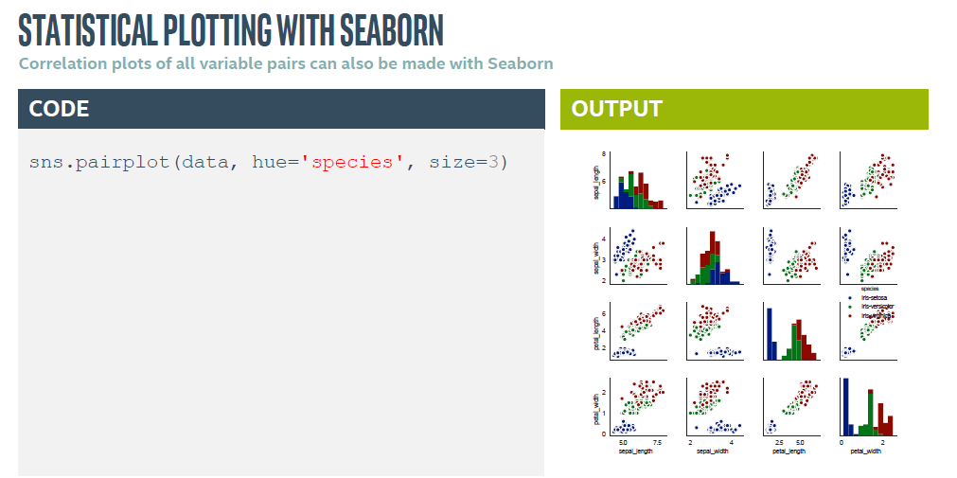

Slide 19
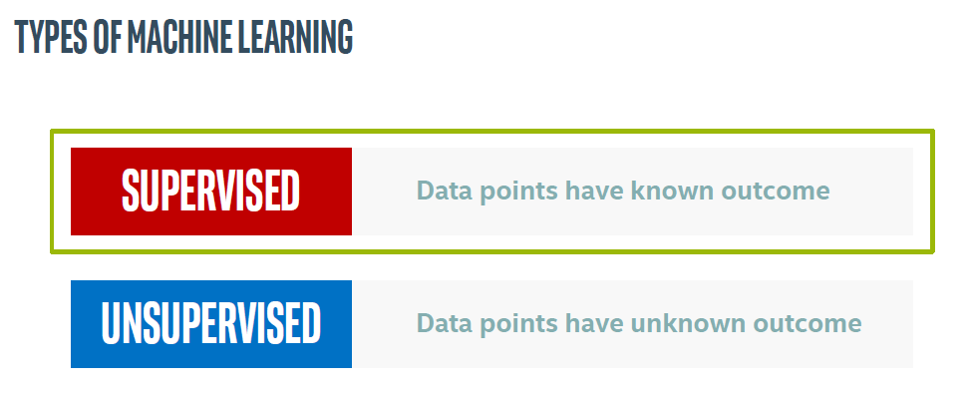
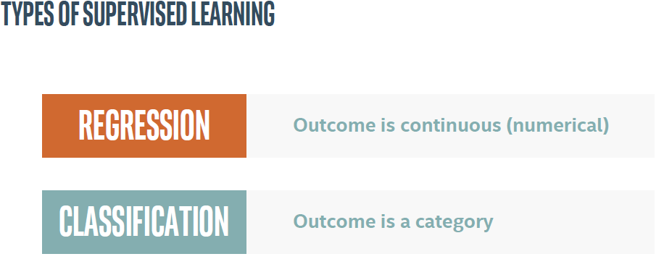
ML from practical implementation perspective

Slide 20
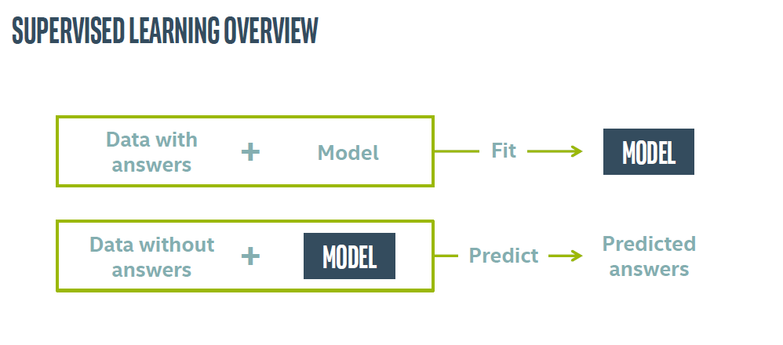
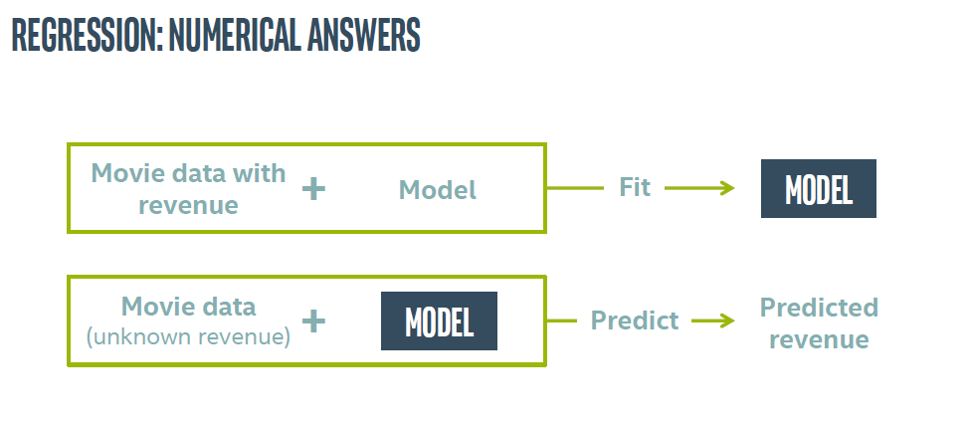

Slide 21
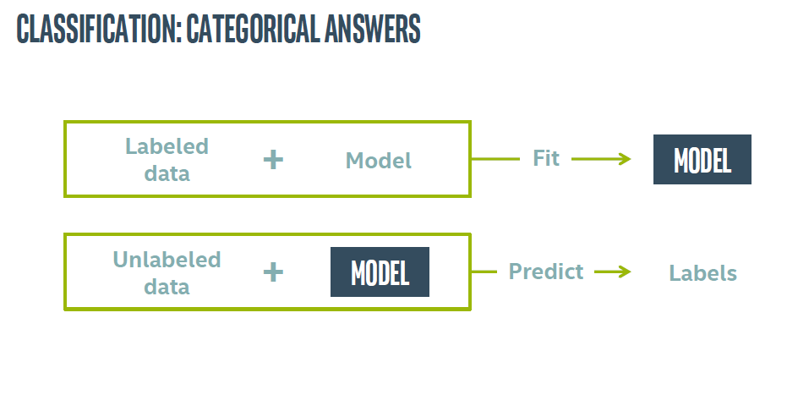
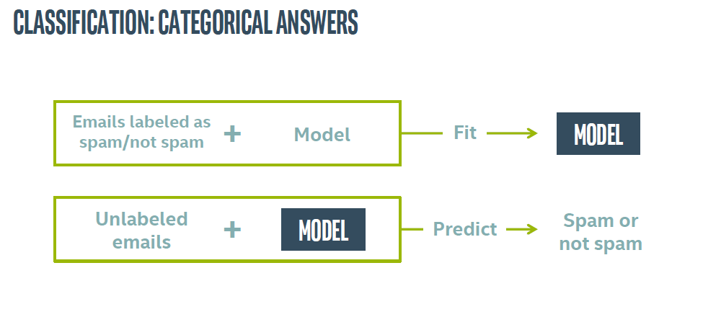

Slide 22
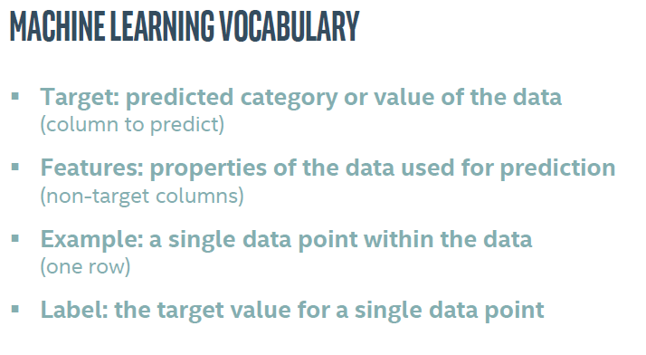
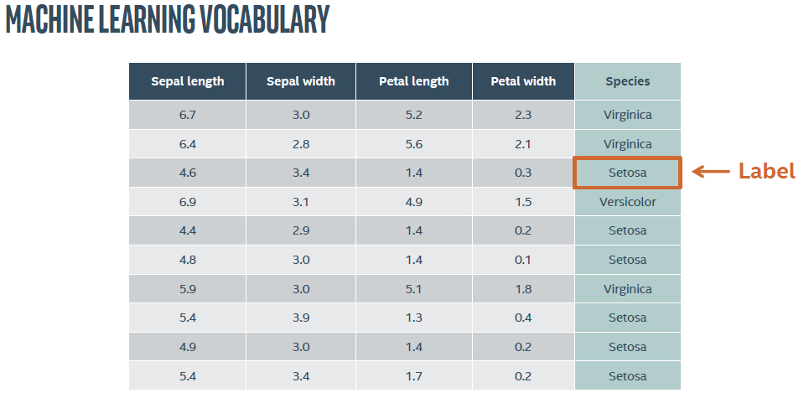

Slide 23
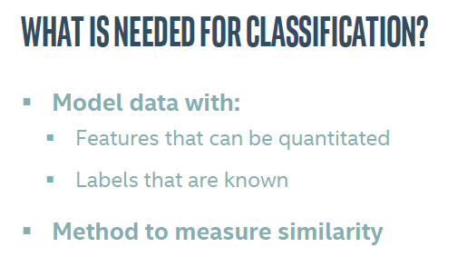
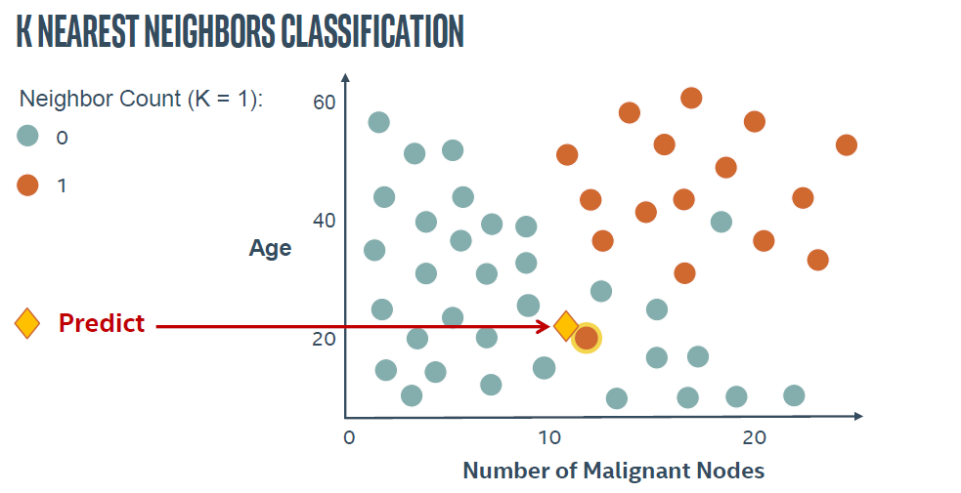
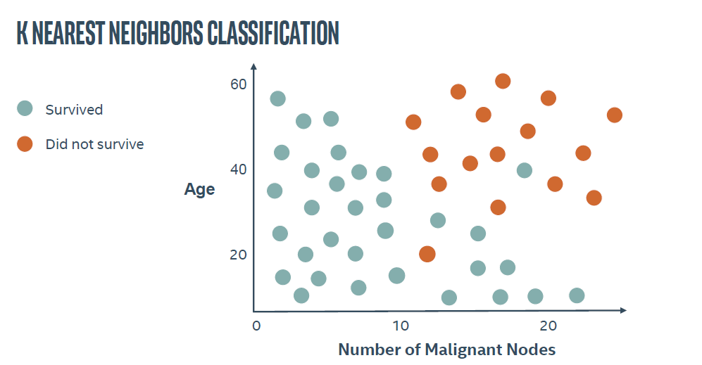

Slide 24
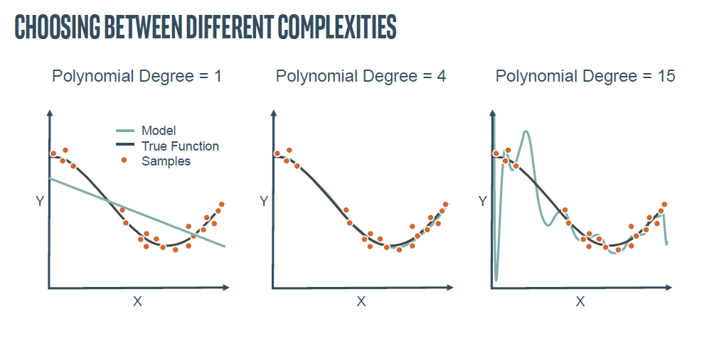
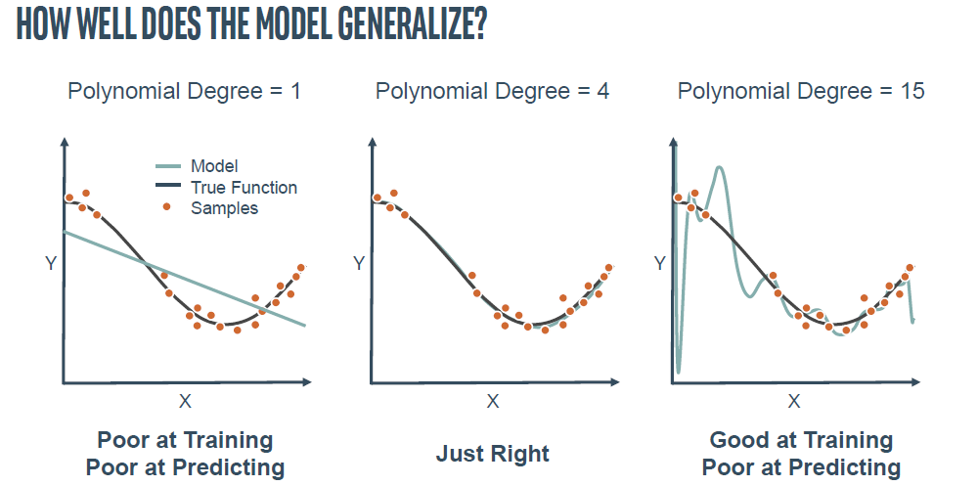

Slide 25
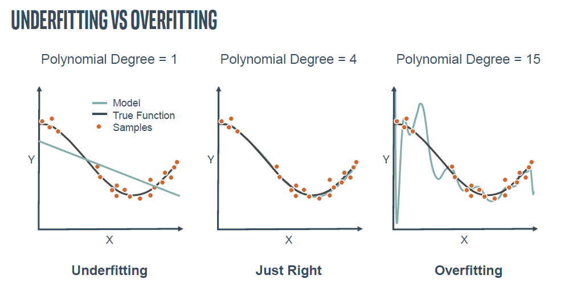
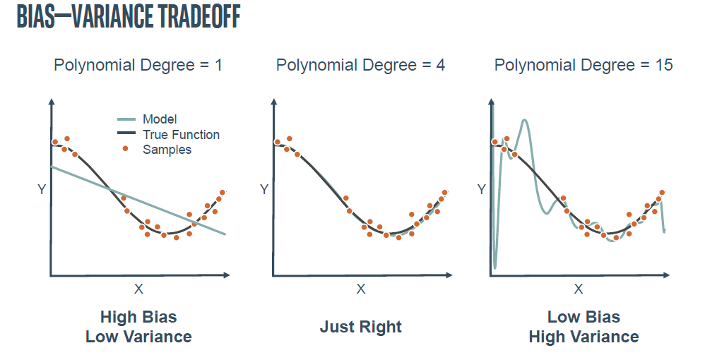

Slide 26
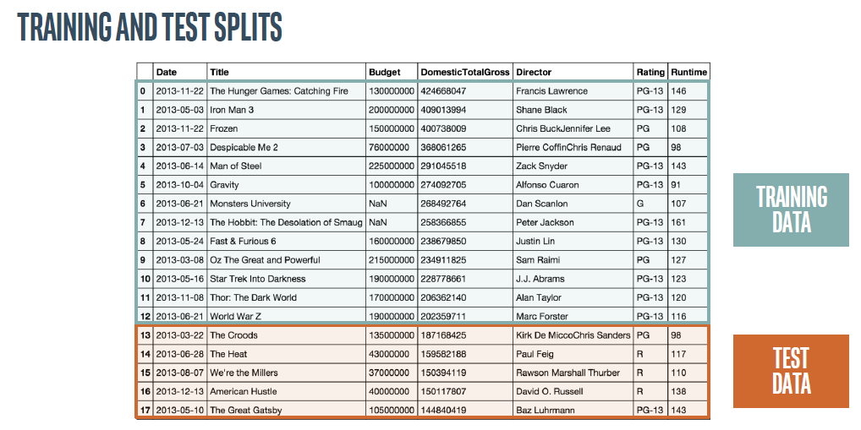
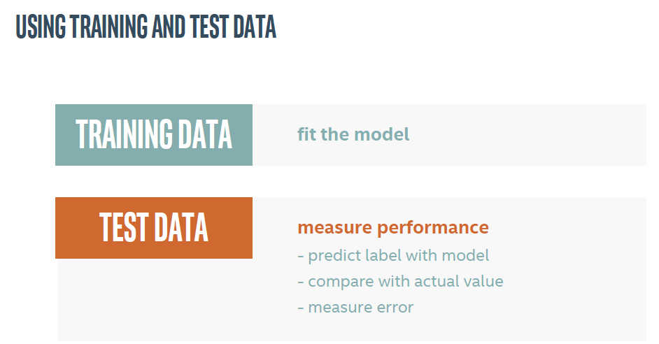

Slide 27
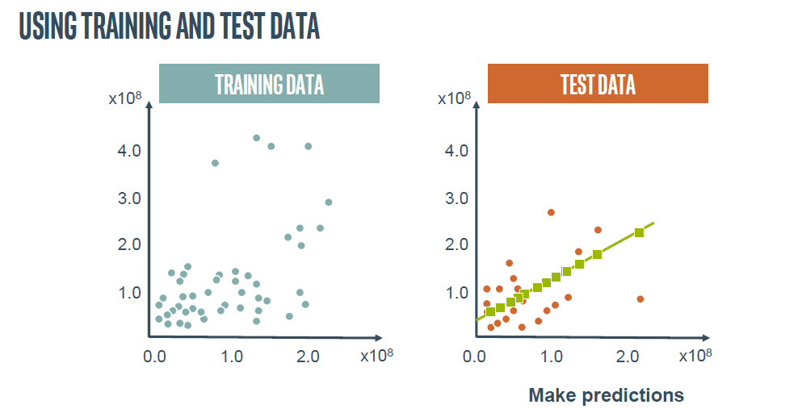
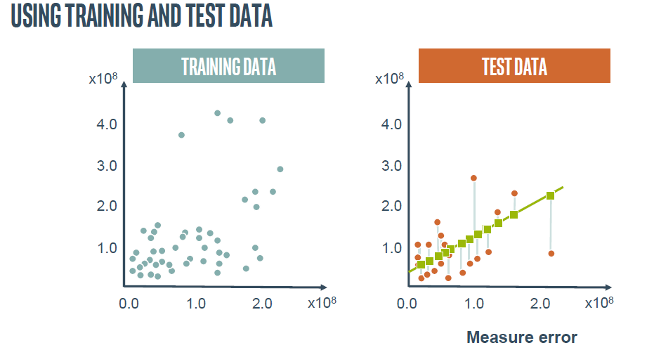

Slide 28
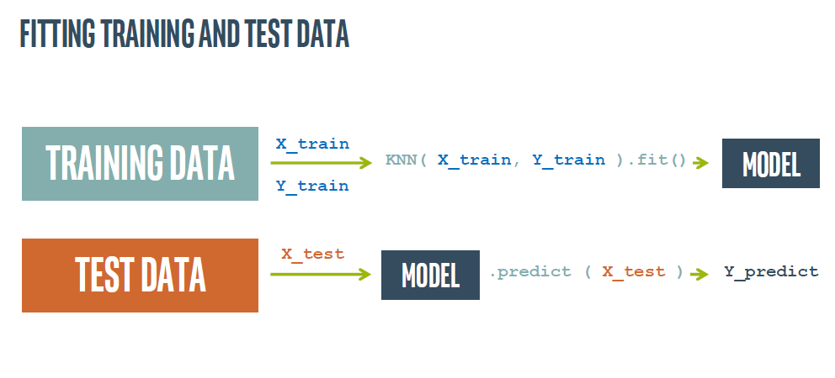
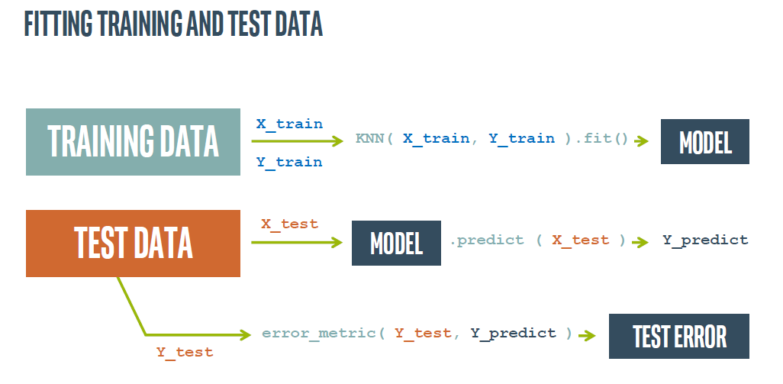

Slide 29
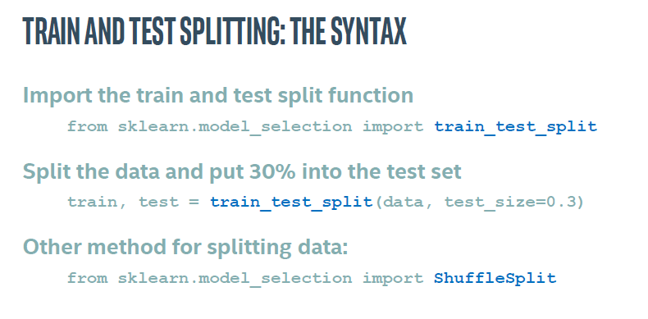
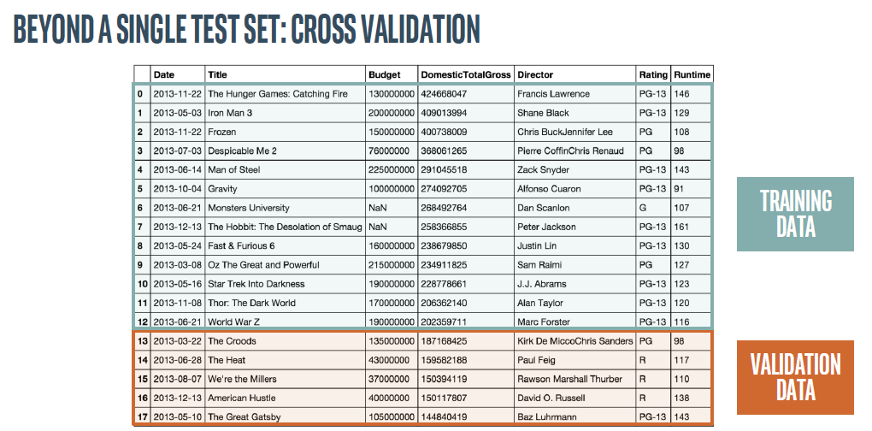

Slide 30
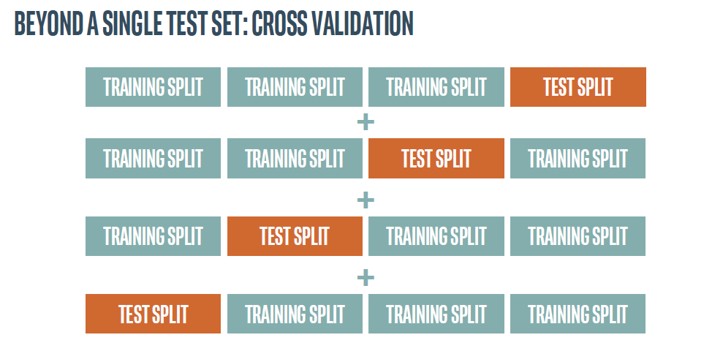

Slide 31
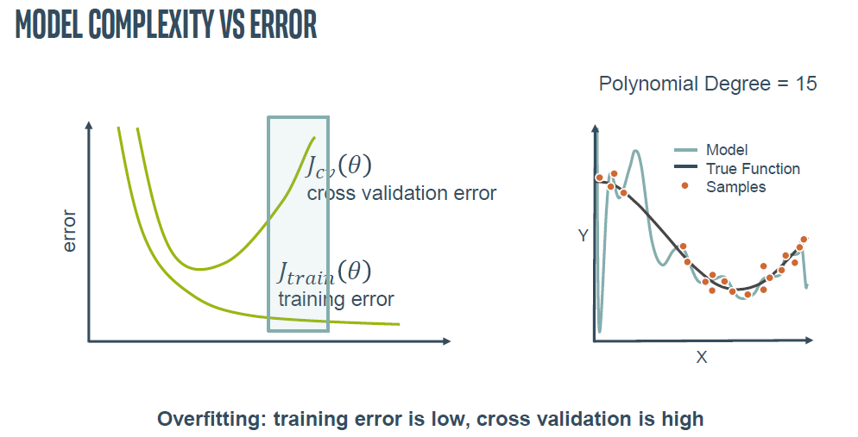
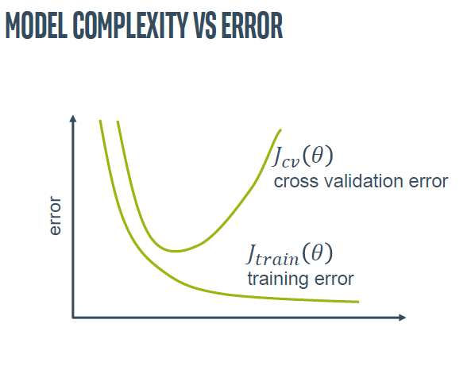
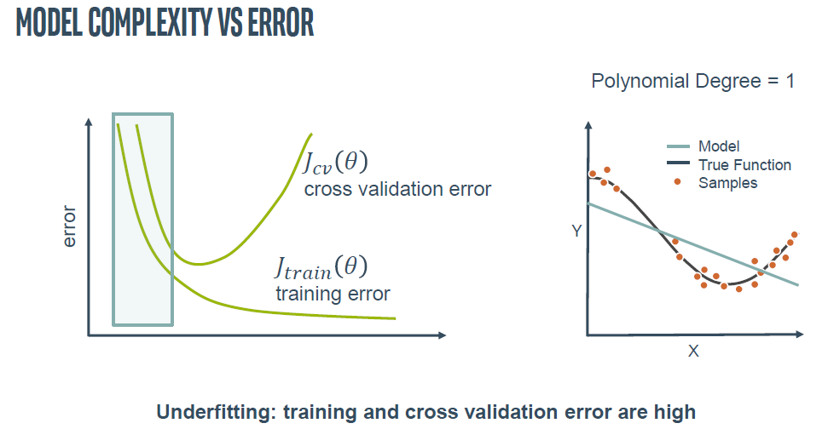
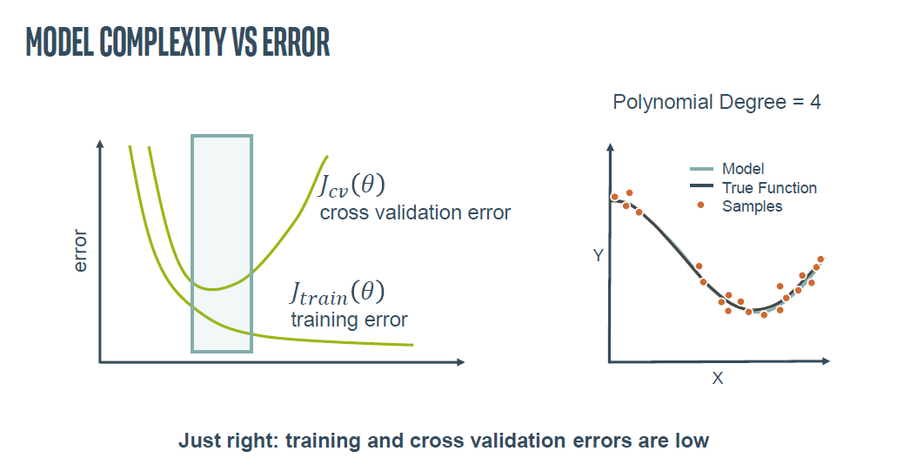

Slide 32
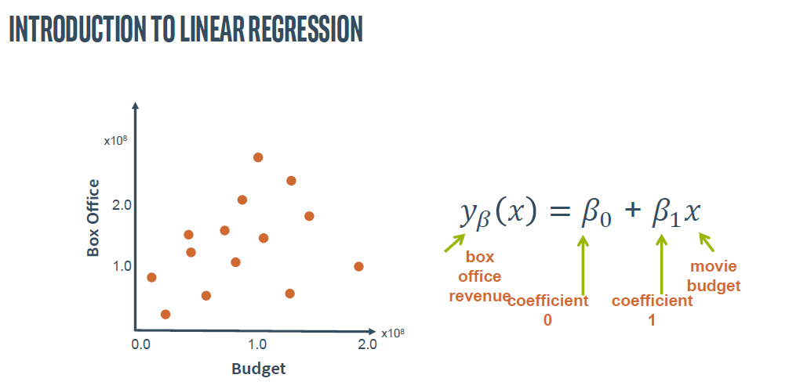
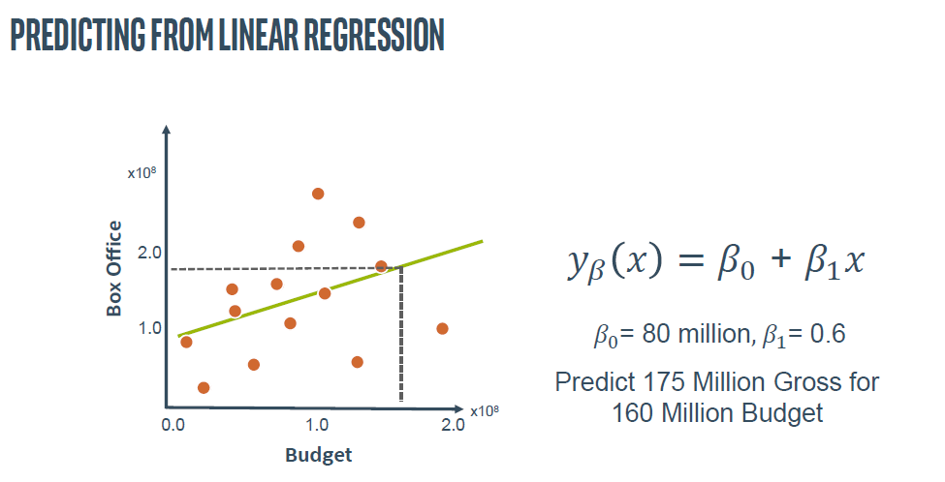


Slide 33





Slide 34


Slide 35


Slide 36


Slide 37




Slide 38



Slide 39





Slide 40





Slide 41


Slide 42


Slide 43





Slide 44
linear regression is perhaps one of the most well-known and well-understood algorithms in statistics and machine learning. Isn't it a technique from statistics?
Predictive modeling is primarily concerned with minimizing the error of a model or making the most accurate predictions possible, at the expense of explainability. We will borrow, reuse and steal algorithms from many different fields, including statistics and use them towards these ends.
The representation of linear regression is an equation that describes a line that best fits the relationship between the input variables (x) and the output variables (y), by finding specific weightings for the input variables called coefficients (B).
For example: y = B0 + B1 * x
We will predict y given the input x and the goal of the linear regression learning algorithm is to find the values for the coefficients B0 and B1.
Different techniques can be used to learn the linear regression model from data, such as a linear algebra solution for ordinary least squares and gradient descent optimization.
Linear regression has been around for more than 200 years and has been extensively studied. Some good rules of thumb when using this technique are to remove variables that are very similar (correlated) and to remove noise from your data, if possible.
It is a fast and simple technique and good first algorithm to try.

Slide 45
logistic regression is another technique borrowed by machine learning from the field of statistics. It is the go-to method for binary classification problems (problems with two class values).
Logistic regression is like linear regression in that the goal is to find the values for the coefficients that weight each input variable.
Unlike linear regression, the prediction for the output is transformed using a non-linear function called the logistic function.
The logistic function looks like a big S and will transform any value into the range 0 to 1. This is useful because we can apply a rule to the output of the logistic function to snap values to 0 and 1 (e.g. IF less than 0.5 then output 1) and predict a class value.
Because of the way that the model is learned, the predictions made by logistic regression can also be used as the probability of a given data instance belonging to class 0 or class 1. This can be useful for problems where you need to give more rationale for a prediction.
Like linear regression, logistic regression does work better when you remove attributes that are unrelated to the output variable as well as attributes that are very similar (correlated) to each other.
It's a fast model to learn and effective on binary classification problems.

Slide 46
why stats is important in machine learning ?
( close relationship between statistics and machine learning).
Statistics and machine learning are two very closely related fields.
In fact, the line between the two can be very fuzzy at times.
Nevertheless, there are methods that clearly belong to the field of statistics that are not only useful, but invaluable when working on a machine learning project.
It would be fair to say that statistical methods are required to effectively work through a machine learning predictive modeling project.
Exploratory data analysis, data summarization, and data visualizations can be used to help frame your predictive modeling problem and better understand the data.
That statistical methods can be used to clean and prepare data ready for modeling.
That statistical hypothesis tests and estimation statistics can aid in model selection and in presenting the skill and predictions from final models.

Slide 47


Slide 48


Slide 49


Slide 50


Slide 51


Slide 52


Slide 53


Slide 54



Slide 55


Slide 56


Slide 57

Machine Learning : A Mind Map Diagram

Slide 58


